Slide 1

XYZ Pvt Ltd Company- Account Department Overview
Presented By:– Rizwan Asif

Slide 2
Agenda
Problem Statement
Supplier Overview
Volume Movement
Findings & Recommendations
BUSINESS QUESTIONS

Slide 3

PROBLEM STATEMENT
Task - To analyze the data and identify procurement trends, supplier limitations, and product-based supplier consolidation.
Suppliers - The sources of the parts can be Tier 1 or Tier 2 suppliers.
Findings – It should help Procurement Department make better strategic decisions for the supply chain.
Goal - To minimize cost impact to the company.

Slide 4
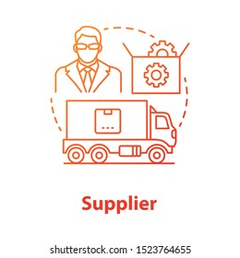
SUPPLIER OVERVIEW
This Report Page gives us a supplier status and its capabilities. Also help the responsible Purchase Group (Buyer) get a focused quick insight for the suppliers.
There are 4 Business unit - Petrol System has highest Purchase Volume(638.45M) from AM& ACP situated in Bangalore and Automotive Engineering has lower purchase volume(59M) from RIL .

Slide 5
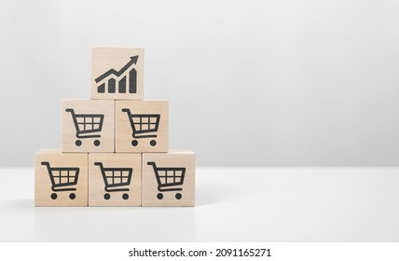
VOLUME MOVEMENT
This report help to analyze the Purchase volume and Tonnage volume movement throughout different years for past comparisons and business planning upcoming demands.
Inserted filter options for business units, purchasing groups, Manufacturing plants, Part Family, supplier names, and raw materials.

Slide 6
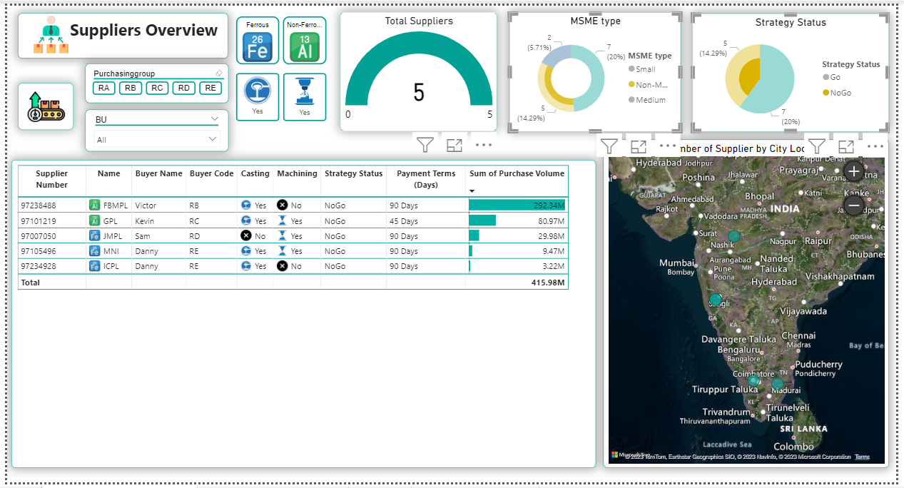
BUSINESS QUESTIONS
Q1- Non-MSME suppliers are basically the ones which have a Turnover > 100cr (1000 Million), Lower than this will be classified into different types of MSME category. How many of these suppliers do we have where we can not grow more business?
Five suppliers

Slide 7
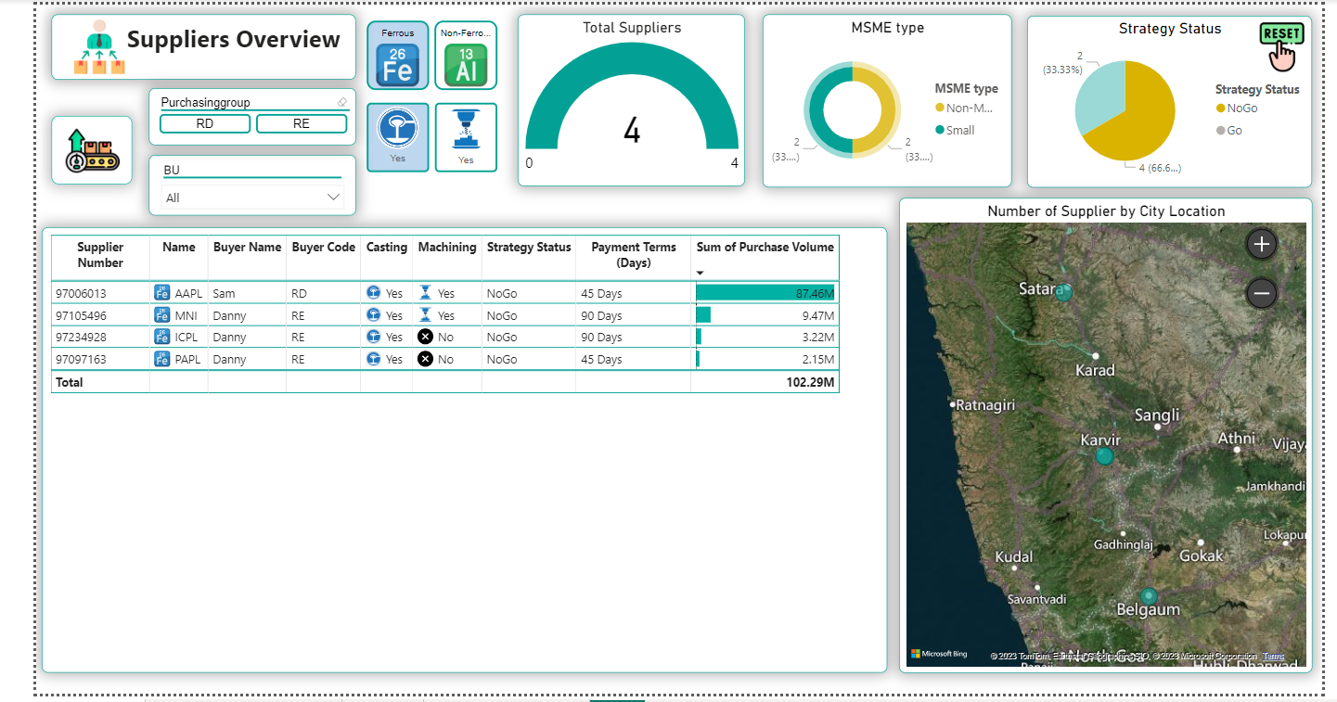
Q2- We have a forecast that the business for ferrous casting will reduce year on year, show me how many of our ferrous casting suppliers we would need to stop business in future as the demand starts coming down.
Four suppliers

Slide 8
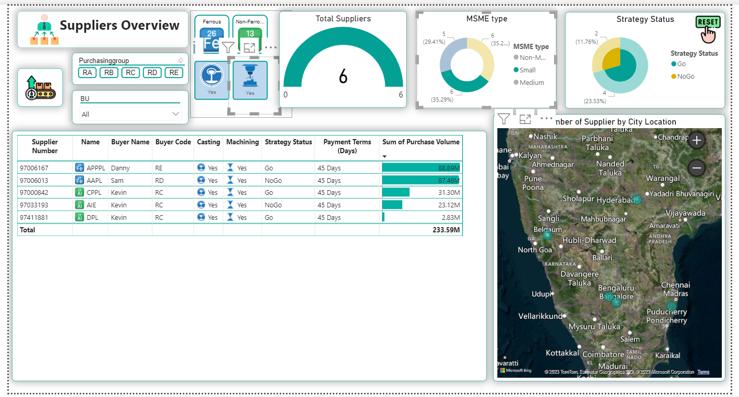
Q3- Find out the list of Small MSME suppliers where the supply chain will not increase till tier 2 suppliers as they will have full Casting and Machining capabilities.
Six suppliers

Slide 9
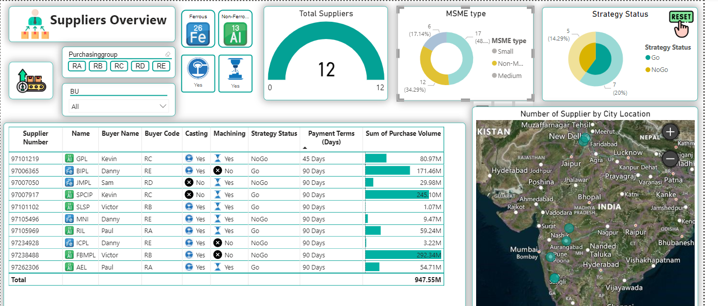
Q4- As per Government rules, we can't increase the payment terms more than 45 days for any type of MSME suppliers. Keeping this in mind do we have any Non-MSME suppliers where we can go above 45 days. If yes, what is the supplier name?
Supplier Name- GPL

Slide 10
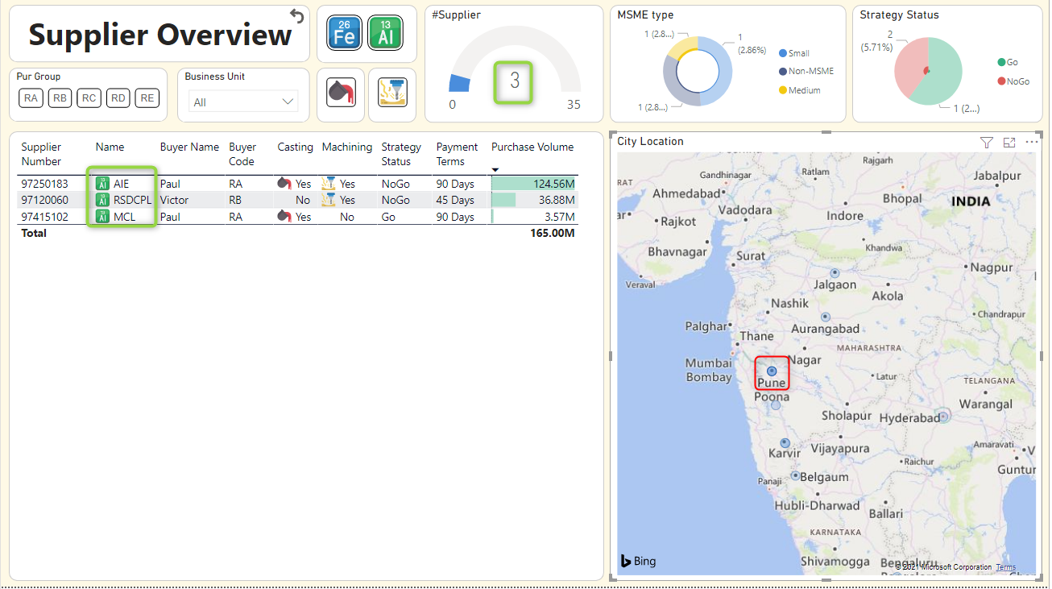
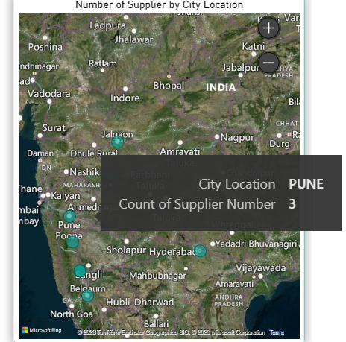
Q5- Pune is one of the Flood Risk Zone, to prepare our supplier for difficult scenarios a taskforce has been assigned. Taskforce wants to know how many of our suppliers are from Pune?
Three suppliers

Slide 11
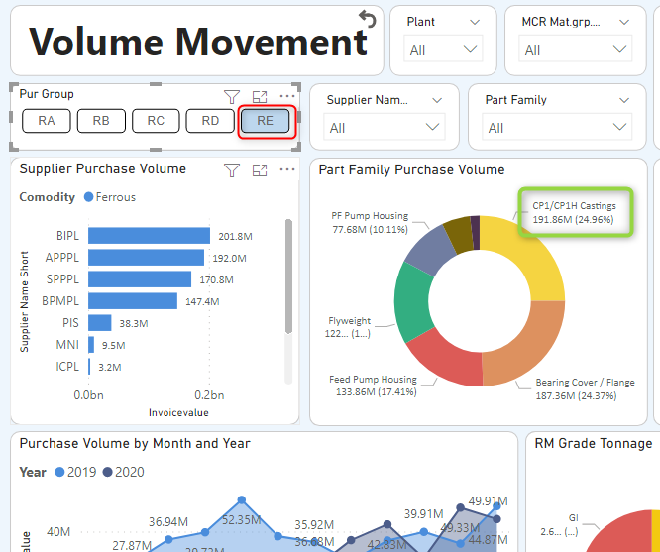
Q6- As Danny is handling a maximum of “Ferrous” suppliers, he wants to know which Part family in ferrous has the highest purchase volume?
Part Family- CP1/CP1H Castings

Slide 12
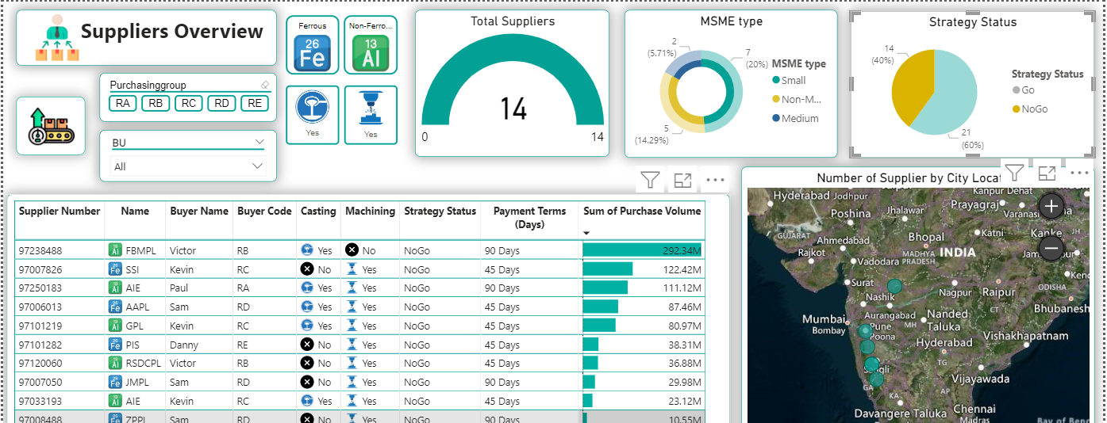
Q7- The Management wants us to minimize the risk with our suppliers, show me the biggest NoGo Suppliers that we have to target first?
Supplier Name - FBMPL

Slide 13
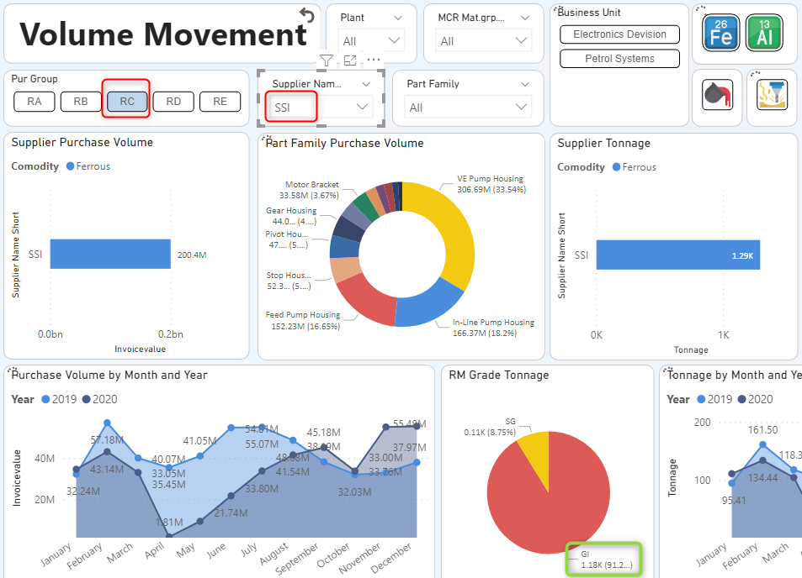
Q8- Kevin is planning to reduce the ferrous raw material prices for further years for his supplier, so far in the past 2 years which is the highest Tonnage consuming RM Grade and how many tons?
RM Grade - GI with 1180.81 Tons

Slide 14
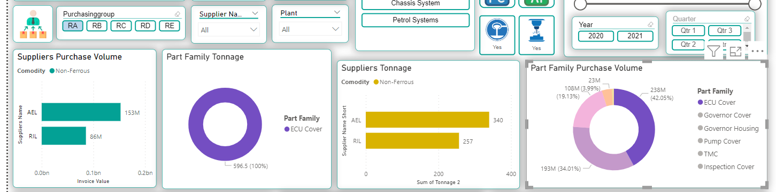
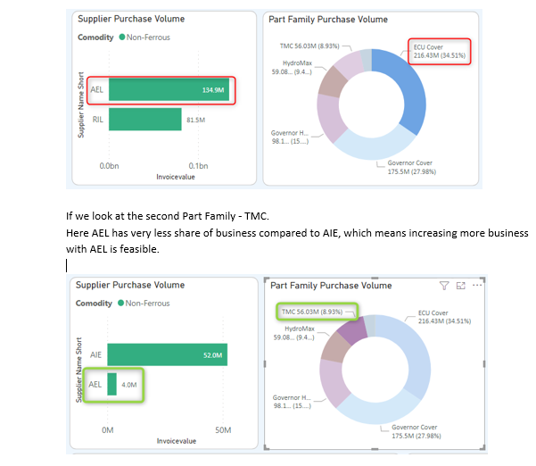
Q9- Paul wants to increase the business with his 2nd biggest supplier. Out of the Part Families supplied by his 2nd biggest supplier, which part family has more than one supplier, also where less purchase volume comes from his second biggest supplier?
Step 1-
Step 1- 1st Part Family PV ECU Cover
AEL has more share compared to RIL. (Business is not feasible with AEL)
Step 2- 2nd Part Family PV TMC
AEL has less share compare to AIE.
(Business is feasible with AEL)
Step 2-

Slide 15
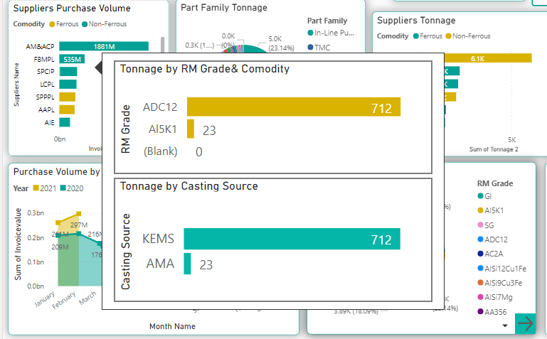
Q10- We want to declutter the supply chain for our top 5 suppliers, we can decide to buy from one single source and negotiate for cost saving. check if they have more than one casting supplier?
Supplier Name- SPCIP

Slide 16
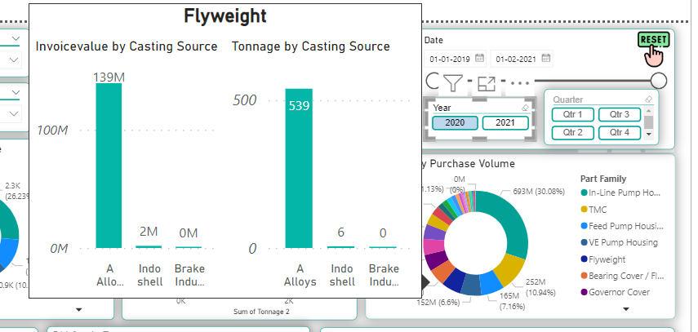
Q11- For the year 2020, how many “tons” of raw material was consumed by the biggest casting source for the “Flyweight” part family. Also what is the name of that source?
Casting Source- A Alloys with 539 Tons

Slide 17
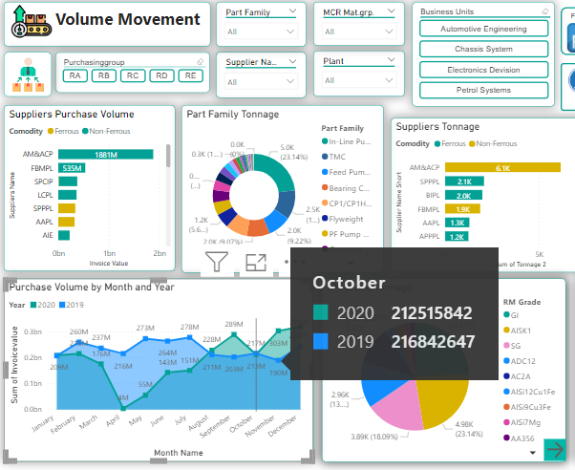
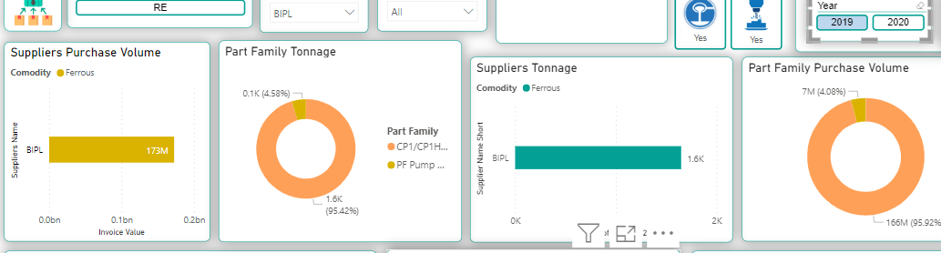
Q12- Danny wants to know how much the purchase volume has fallen down for the month of October in 2020 compared to the previous year for all his suppliers. Also which supplier has the highest purchase volume in 2019.
Purchase Volume has Fallen down by 4M in October 2020 than previous year.
Supplier Name- BIPL has highest Purchase Volume i.e. 173M

Slide 18

FINDINGS
Maximum suppliers from Bangalore and also generated highest invoices from same.
Highest Purchase Volume - Year of 2019 which is 49%
Non-Ferrous has highest purchase volume.
Highest purchase volume with Medium Enterprises than Non-MSME and Small Enterprise.
Good percentage of Growing businesses which is 74% and Not growing are 26%.
Purchase volume for Petrol system is high but for Electronic division is very low i.e 3%.

Slide 19

RECOMMENDATIONS
Supplier Consolidation: Consolidate suppliers in Bangalore to streamline processes and improve supplier management.
Analyze Purchase Volume Trends: Analyze reasons behind high purchase volume in 2019 and subsequent years to predict future trends.
Focus on Non-Ferrous Commodities: Pay attention to non-ferrous commodities for cost optimization and better pricing.
Supplier Diversification: Diversify suppliers to reduce dependency and mitigate risks.
Focus on Growing Businesses: Prioritize engagement with growing businesses for long-term partnerships.

Slide 20


